Slide 1
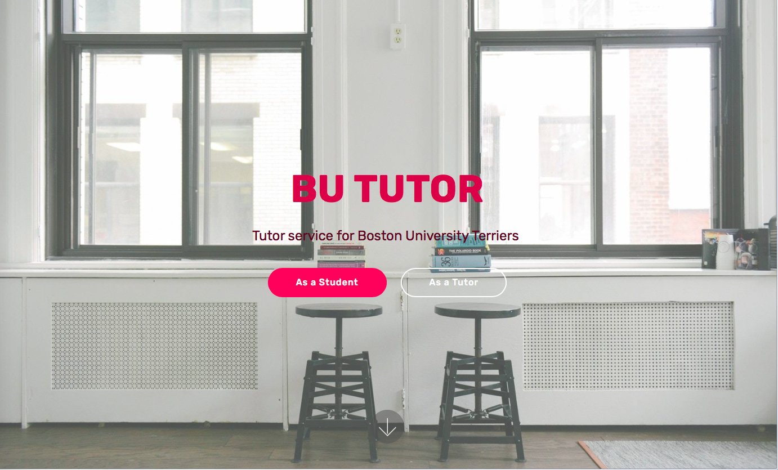
GitHub link: https://github.com/XintongHao/BU-Tutor
Trello link: https://trello.com/b/bgQIvEZm/bu-tutor

Slide 2
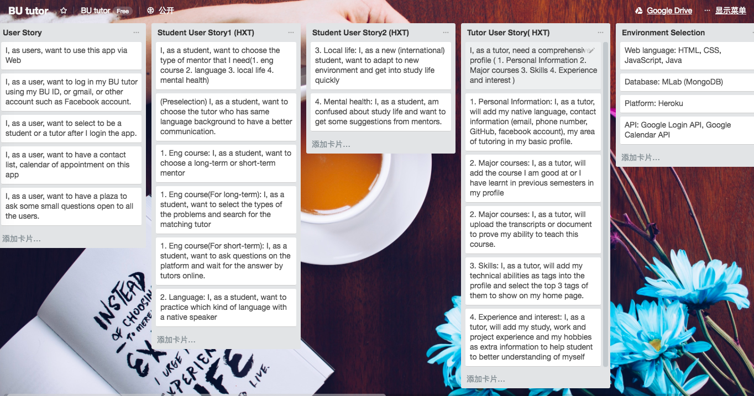
User Stories

Slide 3


Slide 4
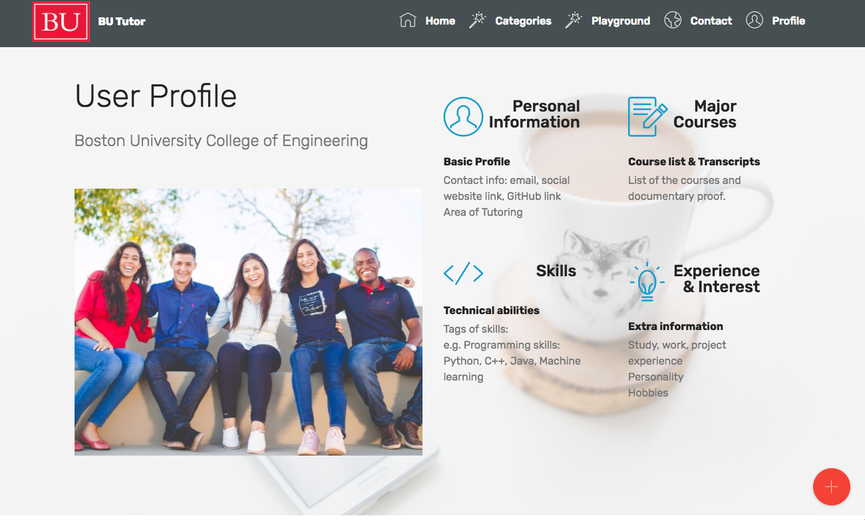

Slide 5
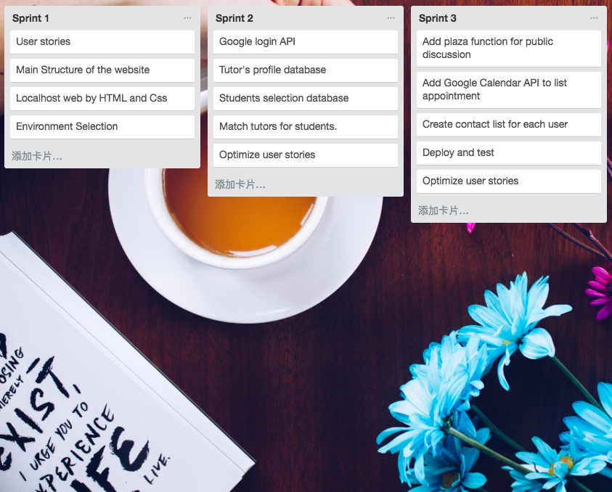

Slide 6
Thank you!
Xintong Hao, Yinzhu Su, Yuchen Wang

